Slide 1
Software Engineering: A Practitioner’s Approach, 6/eChapter 10 Architectural Designcopyright © 1996, 2001, 2005R.S. Pressman & Associates, Inc.For University Use OnlyMay be reproduced ONLY for student use at the university level when used in conjunction with Software Engineering: A Practitioner's Approach.Any other reproduction or use is expressly prohibited.

Slide 2
Why Architecture?
The architecture is not the operational software. Rather, it is a representation that enables a software engineer to:
(1) analyze the effectiveness of the design in meeting its stated requirements,
(2) consider architectural alternatives at a stage when making design changes is still relatively easy, and
(3) reduce the risks associated with the construction of the software.

Slide 3
Why is Architecture Important?
Representations of software architecture are an enabler for communication between all parties (stakeholders) interested in the development of a computer-based system.
The architecture highlights early design decisions that will have a profound impact on all software engineering work that follows and, as important, on the ultimate success of the system as an operational entity.
Architecture “constitutes a relatively small, intellectually graspable model of how the system is structured and how its components work together” [BAS03].

Slide 4
Data Design
At the architectural level …
Design of one or more databases to support the application architecture
Design of methods for ‘mining’ the content of multiple databases
navigate through existing databases in an attempt to extract appropriate business-level information
Design of a data warehouse—a large, independent database that has access to the data that are stored in databases that serve the set of applications required by a business

Slide 5
Data Design
At the component level …
refine data objects and develop a set of data abstractions
implement data object attributes as one or more data structures
review data structures to ensure that appropriate relationships have been established
simplify data structures as required

Slide 6
Data Design—Component Level
1. The systematic analysis principles applied to function and behavior should also be applied to data.
2. All data structures and the operations to be performed on each should be identified.
3. A data dictionary should be established and used to define both data and program design.
4. Low level data design decisions should be deferred until late in the design process.
5. The representation of data structure should be known only to those modules that must make direct use of the data contained within the structure.
6. A library of useful data structures and the operations that may be applied to them should be developed.
7. A software design and programming language should support the specification and realization of abstract data types.

Slide 7
Architectural Styles
Each style describes a system category that encompasses: (1) a set of components (e.g., a database, computational modules) that perform a function required by a system, (2) a set of connectors that enable “communication, coordination and cooperation” among components, (3) constraints that define how components can be integrated to form the system, and (4) semantic models that enable a designer to understand the overall properties of a system by analyzing the known properties of its constituent parts.
Data-centered architectures
Data flow architectures
Call and return architectures
Object-oriented architectures
Layered architectures

Slide 8
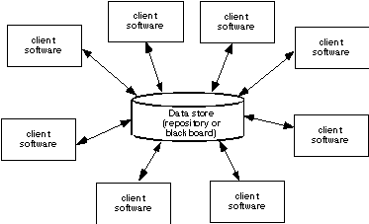
Data-Centered Architecture

Slide 9
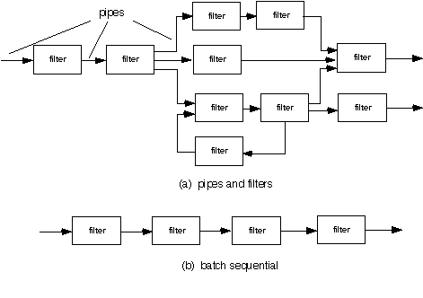
Data Flow Architecture

Slide 10
Call and Return Architecture

Slide 11
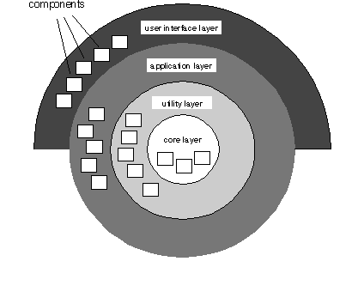
Layered Architecture

Slide 12
Architectural Patterns
Concurrency—applications must handle multiple tasks in a manner that simulates parallelism
operating system process management pattern
task scheduler pattern
Persistence—Data persists if it survives past the execution of the process that created it. Two patterns are common:
a database management system pattern that applies the storage and retrieval capability of a DBMS to the application architecture
an application level persistence pattern that builds persistence features into the application architecture
Distribution— the manner in which systems or components within systems communicate with one another in a distributed environment
A broker acts as a ‘middle-man’ between the client component and a server component.

Slide 13
Architectural Design
The software must be placed into context
the design should define the external entities (other systems, devices, people) that the software interacts with and the nature of the interaction
A set of architectural archetypes should be identified
An archetype is an abstraction (similar to a class) that represents one element of system behavior
The designer specifies the structure of the system by defining and refining software components that implement each archetype

Slide 14
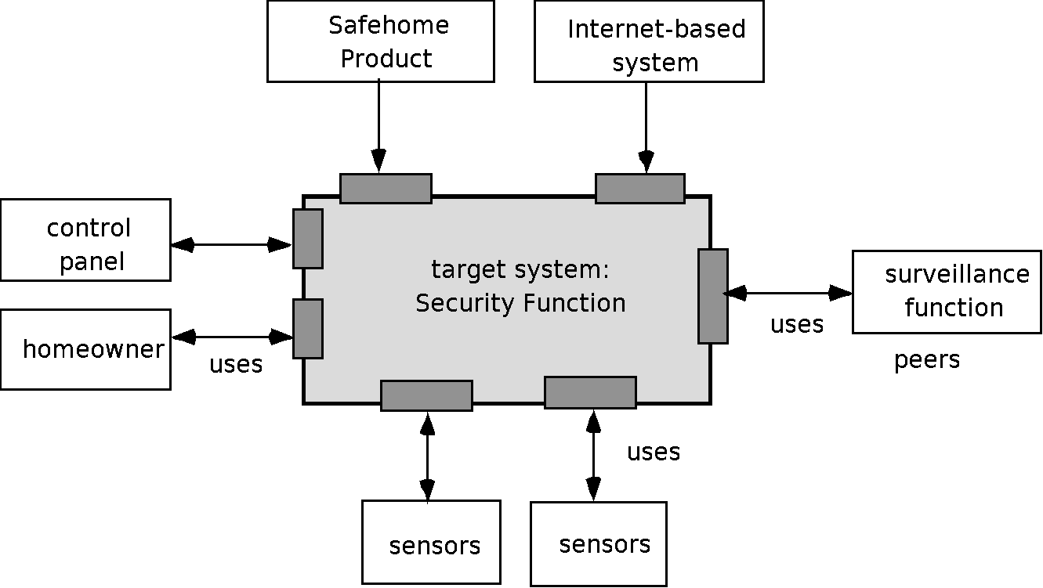
Architectural Context

Slide 15
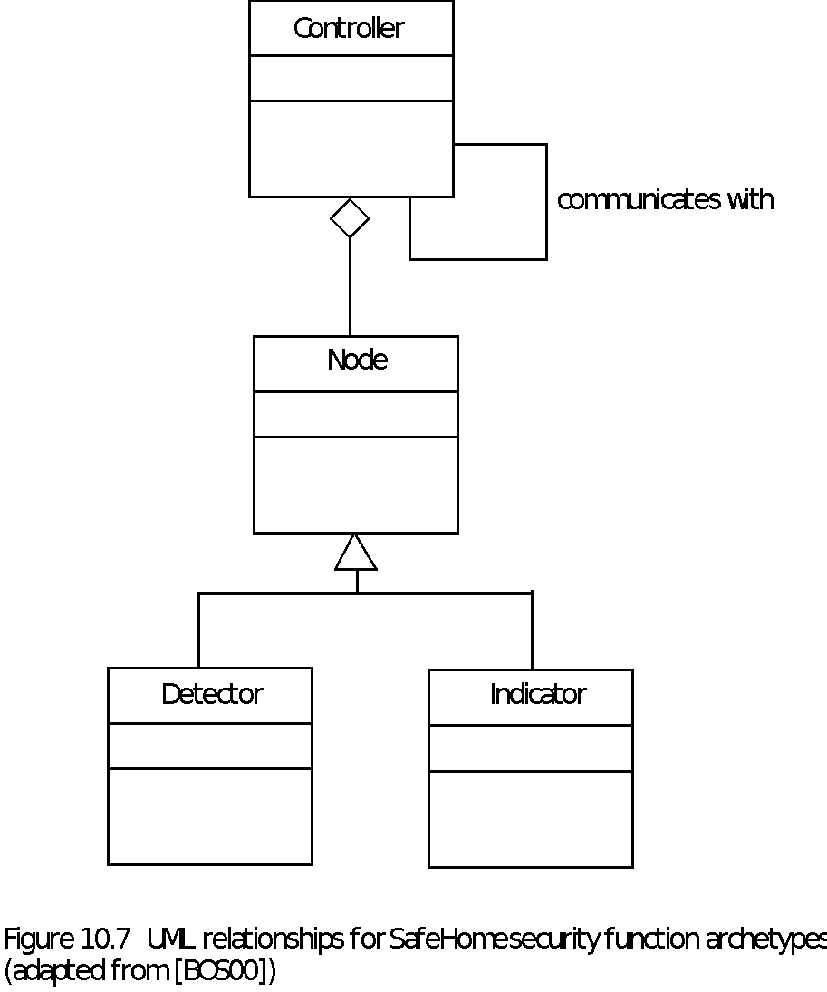
Archetypes

Slide 16
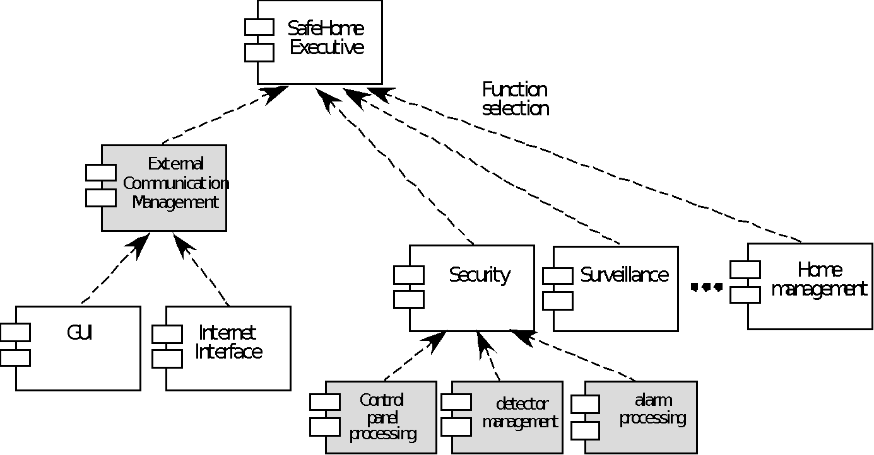
Component Structure

Slide 17
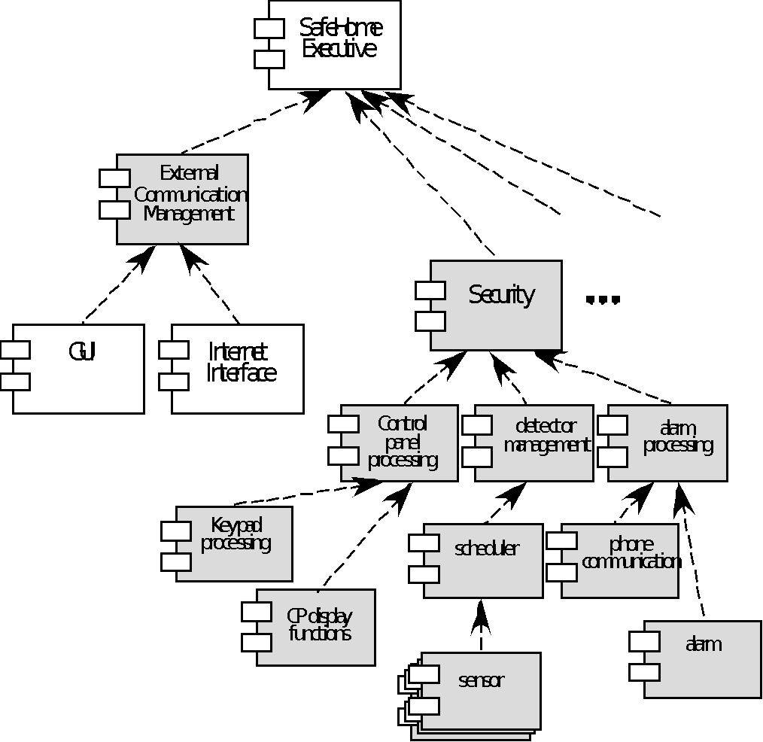
Refined Component Structure

Slide 18
Analyzing Architectural Design
1. Collect scenarios.
2. Elicit requirements, constraints, and environment description.
3. Describe the architectural styles/patterns that have been chosen to address the scenarios and requirements:
• module view
• process view
• data flow view
4. Evaluate quality attributes by considered each attribute in isolation.
5. Identify the sensitivity of quality attributes to various architectural attributes for a specific architectural style.
6. Critique candidate architectures (developed in step 3) using the sensitivity analysis conducted in step 5.

Slide 19
An Architectural Design Method
customer requirements
"four bedrooms, three baths,
lots of glass ..."
architectural design

Slide 20
Deriving Program Architecture
Program
Architecture

Slide 21
Partitioning the Architecture
“horizontal” and “vertical” partitioning are required

Slide 22
Horizontal Partitioning
define separate branches of the module hierarchy for each major function
use control modules to coordinate communication between functions
function 1
function 3
function 2

Slide 23
Vertical Partitioning: Factoring
design so that decision making and work are stratified
decision making modules should reside at the top of the architecture
decision-makers
workers

Slide 24
Why Partitioned Architecture?
results in software that is easier to test
leads to software that is easier to maintain
results in propagation of fewer side effects
results in software that is easier to extend

Slide 25
Structured Design
objective: to derive a program architecture that is partitioned
approach:
the DFD is mapped into a program architecture
the PSPEC and STD are used to indicate the content of each module
notation: structure chart

Slide 26
Flow Characteristics
Transform flow
Transaction
flow

Slide 27
General Mapping Approach
isolate incoming and outgoing flow
boundaries; for transaction flows, isolate
the transaction center
working from the boundary outward, map
DFD transforms into corresponding modules
add control modules as required
refine the resultant program structure
using effective modularity concepts

Slide 28
Transform Mapping

Slide 29
Factoring

Slide 30
First Level Factoring
main
program
controller
input
processing
output
controller
controller
controller

Slide 31
Second Level Mapping

Slide 32
Transaction Flow
incoming flow
action path
T

Slide 33
Transaction Example
fixture setting
fixture
servos
commands
operator
process
operator
report
display
commands
screen
robot control
robot
control
software
assembly
record
in reality, other
commands
would also be shown

Slide 34
Refining the Analysis Model
1.
write an English language processing narrative
for the level 01 flow model
2.
apply noun/verb parse to isolate processes, data
items, store and entities
3.
develop level 02 and 03 flow models
4.
create corresponding data dictionary entries
5.
refine flow models as appropriate
... now, we're ready to begin design!

Slide 35
Deriving Level 1
Processing narrative for " process operator commands"
Processing narrative for " process operator commands"
Process operator command software reads operator commands from
the cell operator. An error message is displayed for invalid commands.
The command type is determined for valid commands and appropriate
action is taken. When fixture commands are encountered, fixture
status is analyzed and a fixture setting is output to the fixture servos.
When a report is selected, the assembly record file is read and a
noun-verb
report is generated and displayed on the operator display screen.
When robot control switches are selected, control values are sent to
parse
the robot control system.
Process operator command software
reads
operator
commands
from
the cell
operator
. An
error message
is
displayed
for
invalid commands
.
The
command type
is
determined
for
valid commands
and appropriate
action is
taken
. When
fixture commands
are
encountered
,
fixture
status
is
analyzed
and a
fixture setting
is
output
to the
fixture servos
.
When a
report
is
selected,
the
assembly record file
is
read
and a
report is
generated
and
displayed
on the operator
display screen
.
When
robot control switches
are
selected
,
control value
s are
sent
to
the
robot control system.

Slide 36
Level 1 Data Flow Diagram
operator
Error msg
fixture
servos
commands
status
read
operator
commands
analyze
fixture
status
determine
command
type
Fixture setting
fixture
Valid
command
display
screen
select report
control robot
generate
report
send
control
value
robot control
assembly record

Slide 37
Level 2 Data Flow Diagram
command
produce
error msg
error msg
read
command
format
setting
fixture setting
status
determine
setting
validate
command
invalid command
read
fixture
status
command
raw setting
determine
type
combined
status
valid command
read
record
robot control
record
calculate
output
values
send
control
value
values
format
report
assembly
record
report
start/stop

Slide 38
Transaction Mapping Principles
isolate the incoming flow path
define each of the action paths by looking for
the "spokes of the wheel"
assess the flow on each action path
define the dispatch and control structure
map each action path flow individually

Slide 39
Transaction Mapping
Data flow model
f
a
e
b
d
mapping
t
x1
g
i
program structure
l
h
k
j
b
t
m
n
a
x2
x3
x4
d
e
f
g
h
x3.1
l
m
n
i
j
k

Slide 40
Isolate Flow Paths
command
produce
error msg
error msg
read
command
format
setting
fixture setting
status
determine
setting
validate
command
invalid command
read
fixture
status
command
raw setting
determine
type
combined
status
valid command
read
record
robot control
record
calculate
output
values
send
control
value
values
format
report
assembly
record
report
start/stop

Slide 41
Map the Flow Model

Slide 42
Refining the Structure Chart

